Slide 1
Mind, Body, Spirit
Process Book
Jordan Tecumseh
Spring 2022
ART2602C Intro to Digital Media

Slide 2
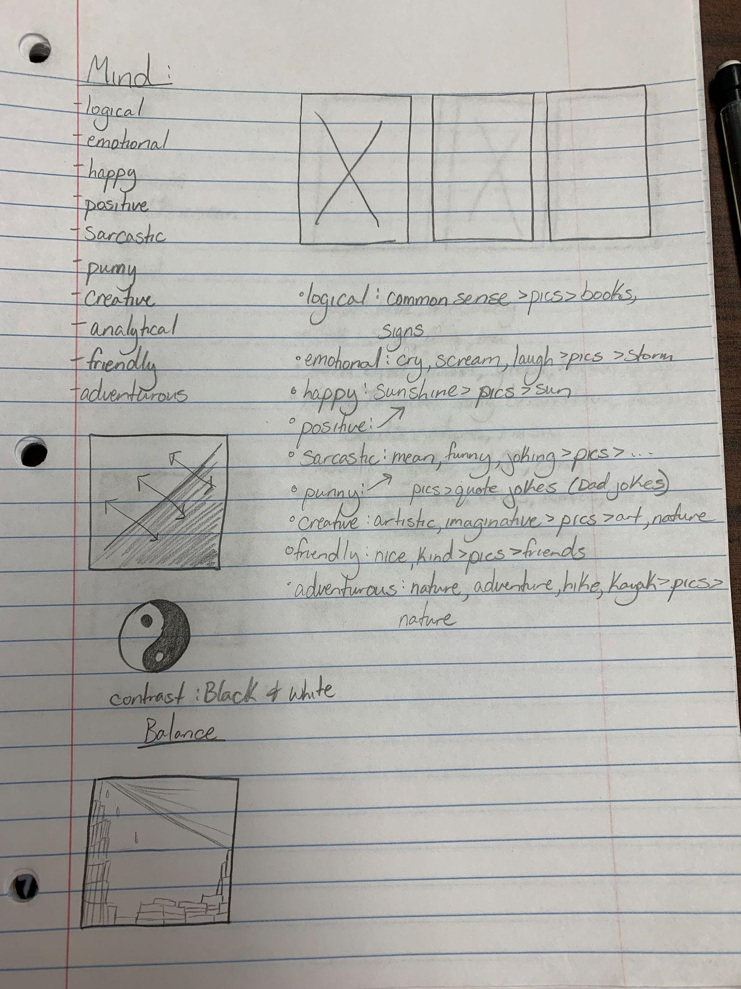
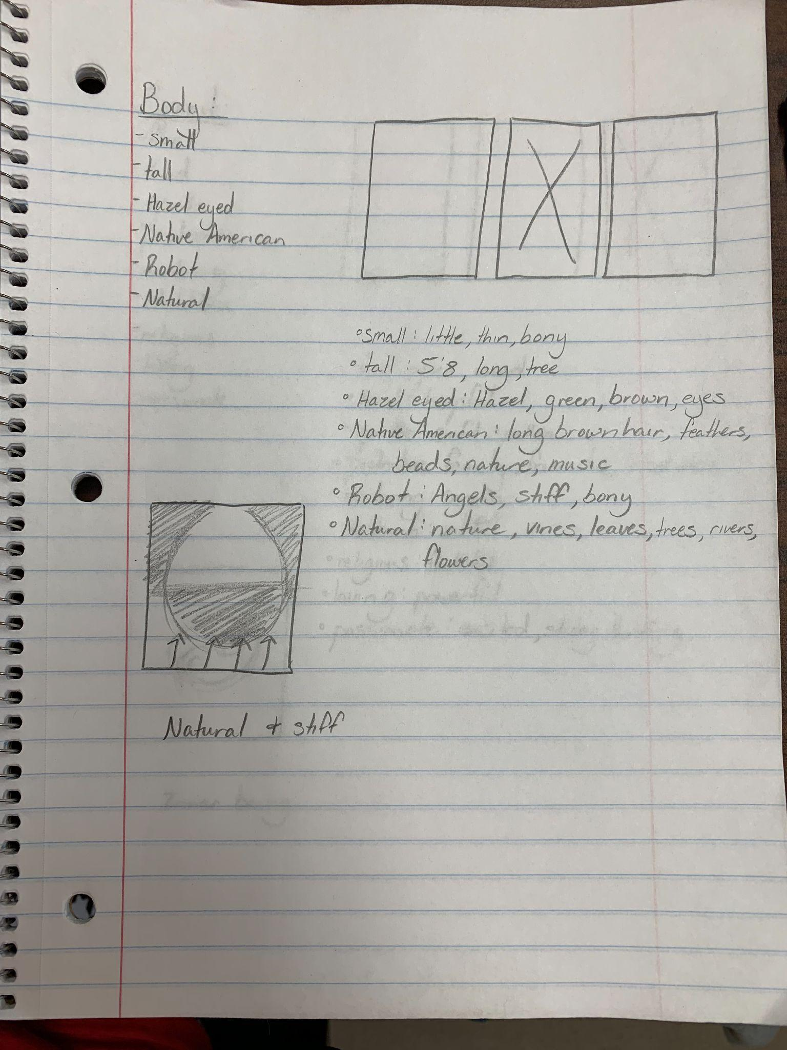
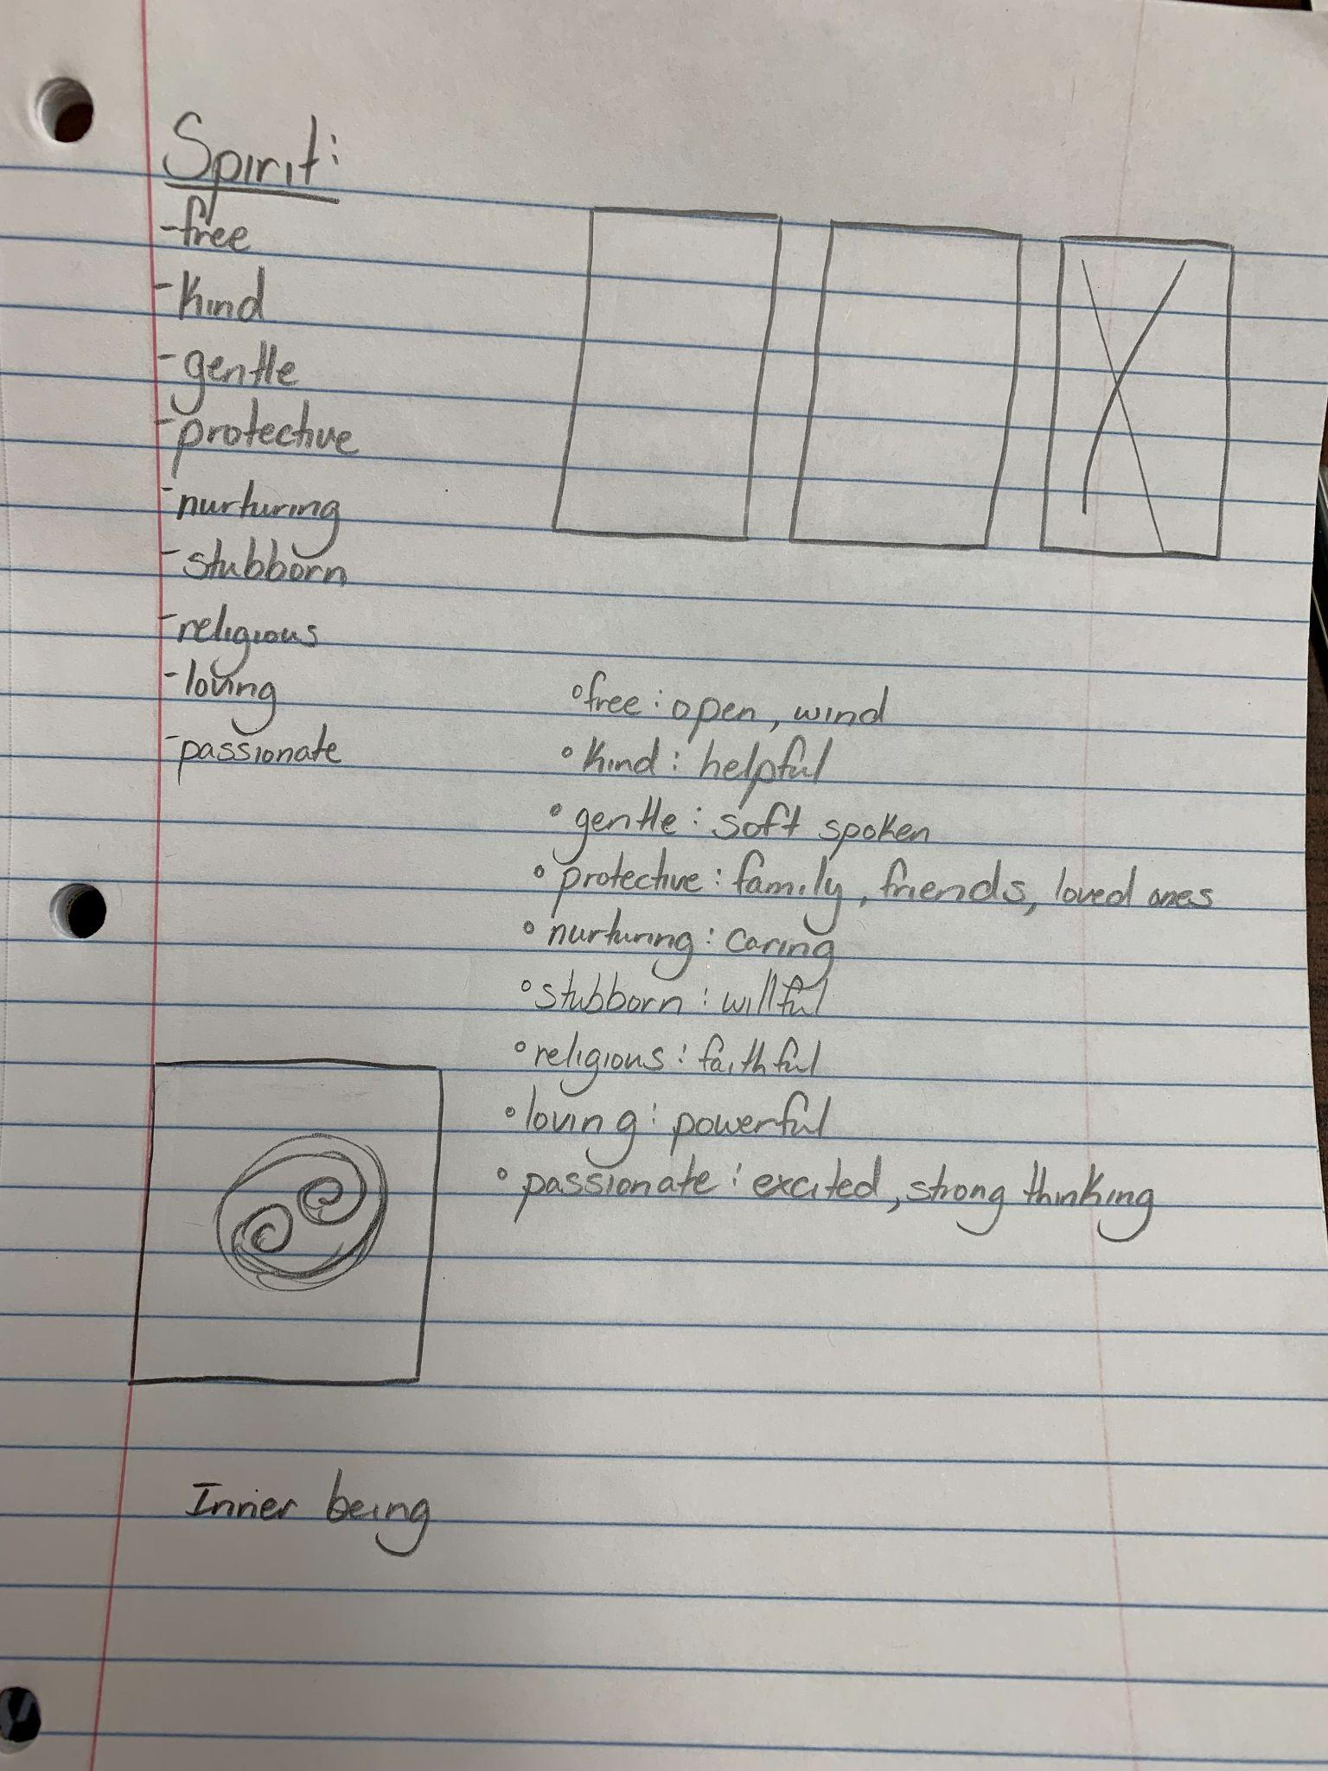
Brainstorming

Slide 3
Mind Words:
Emotional
Positive
Logical
Creative
Friendly
Balanced

Slide 4
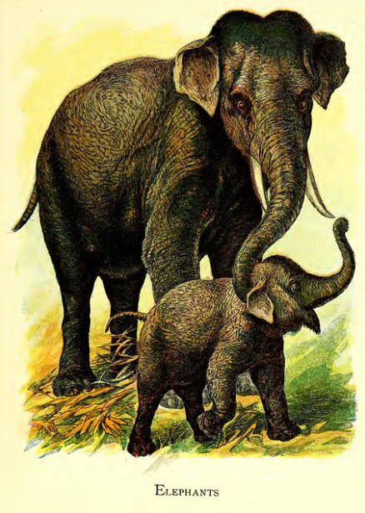
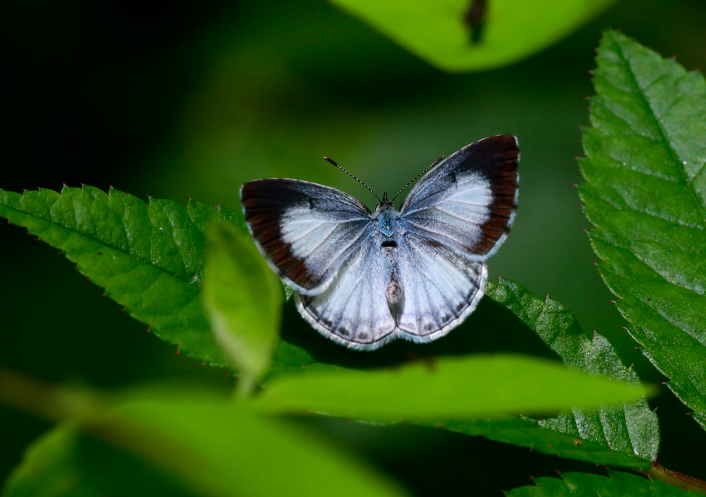
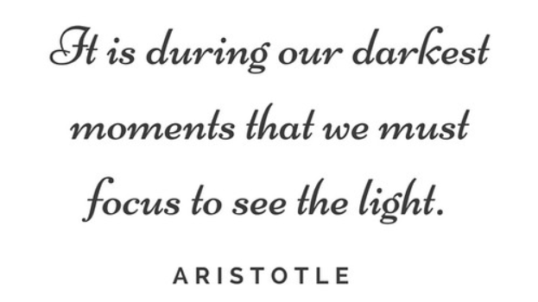
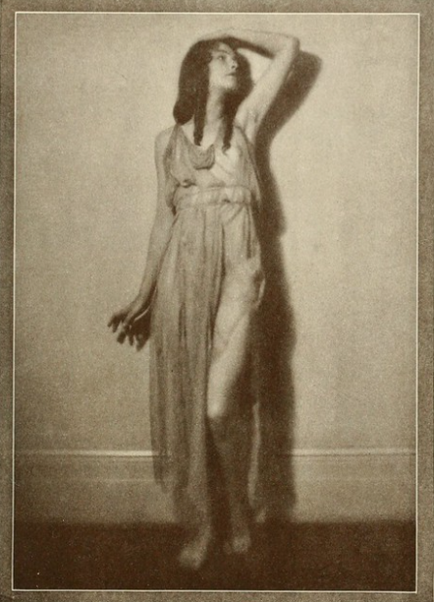
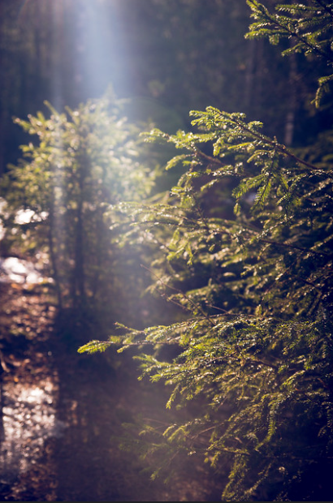
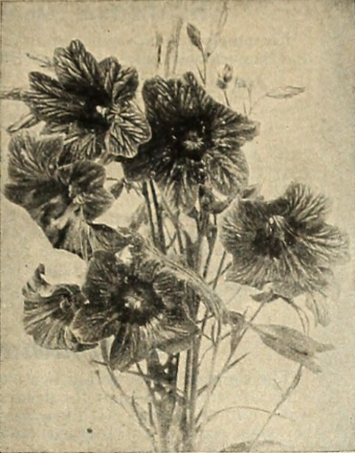
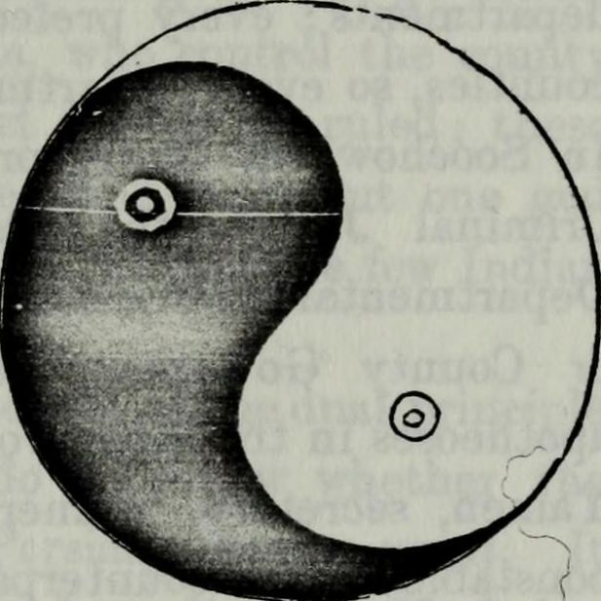
Mind Pictures:

Slide 5
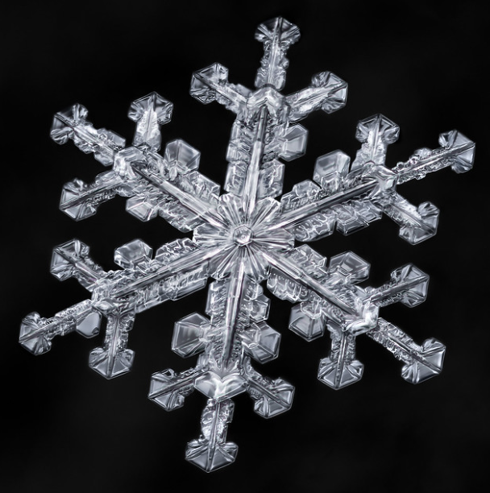
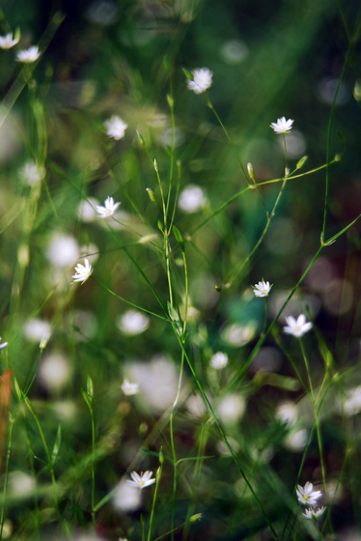
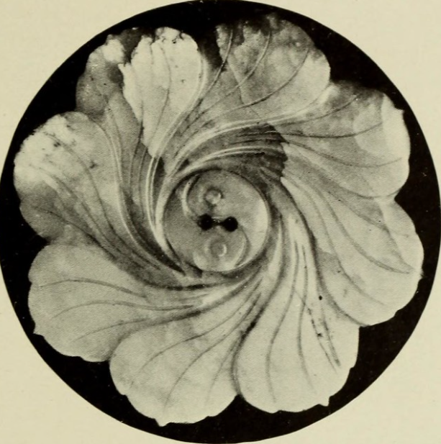
Possible: body, spirit

Slide 6
Procedural Process
In this mind, body, spirit collage project I was introduced to photoshop. I had difficulty using the different techniques and functions that this app provided. I am still not clear on how to fully use this app but throughout the process of my collage, I was able to learn a few helpful things. For my first collage, Mind, I had difficulty choosing a first layer that I wanted as my background. I felt that this image would be the standing stone for the rest of my images and wanted to make it something that could relate with the rest of my images.

